Slide 1
TO FINETUNE A LANGUAGE TO GENERATE HEADING TO A PARAGRAPH
DEEP LEARNING SECTION : 2
TEAM NAME: INNOVATORS

Slide 2
STATEMENT
To fine tune the language and to give the title for the paragraph automatically using deep learning

Slide 3
OBJECTIVE
To finetune the model
To give the title for the paragraph

Slide 4
FLOW DIAGRAM
INPUT
DATA EXTRATION
OUTPUT MODEL
FINETUNING THE LANGUAGE

Slide 5


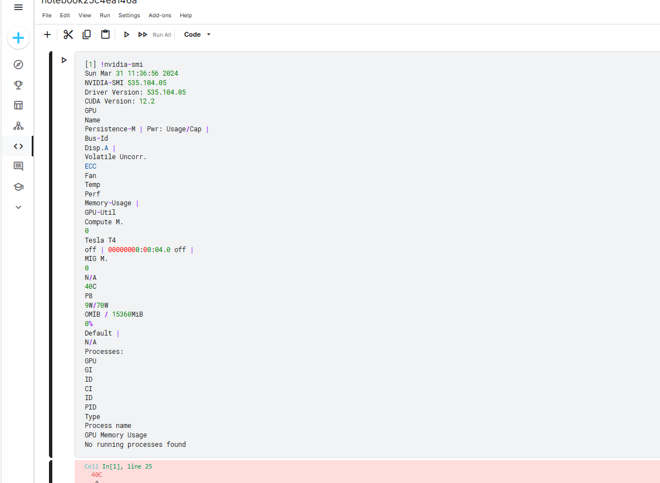

STEPS FOLLOWED

Slide 6
THANK YOU

